Slide 1


SPLeaP: Soft Pooling of Learned Parts for Image Classification
Praveen Kulkarni
Supervised by:
Frédéric Jurie, Joaquin Zepeda, Patrick Pérez, Louis Chevallier

Slide 2
Outline
Background:
Part-Based Models ( PBMs ) in context of Image Classification.
Motivation and Challenges.
Prior works.
Our Method:
Novel joint learning framework for learning parameters in PBMs.
Contribution:
A boosted non-linear part classifiers.
Parametric Soft-Max Pooling.
Results:
Datasets (Pascal VOC, MITindoor67 and Willow actions).
Comparison to prior SOA approaches.
Conclusion
Extensions

Slide 3
Outline
Background:
Part-Based Models ( PBMs ) in context of Image Classification.
Motivation and Challenges.
Prior works.
Our Method:
Novel joint learning framework for learning parameters in PBMs.
Contribution:
A boosted non-linear part classifiers.
Parametric Soft-Max Pooling.
Results:
Datasets (Pascal VOC, MITindoor67 and Willow actions).
Comparison to prior SOA approaches.
Conclusion
Extensions

Slide 4
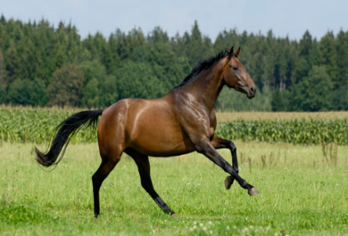

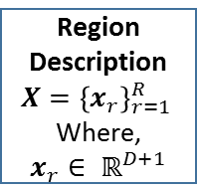
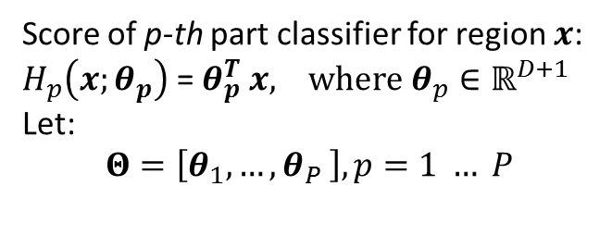
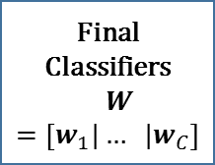
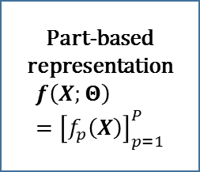
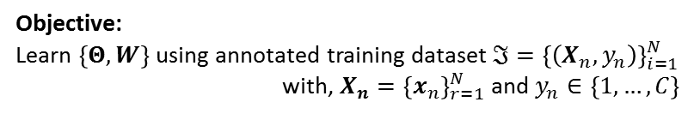
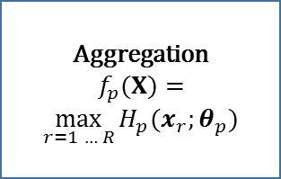

Background
Part-Based Models (PBMs) in context of Image Classification.
Bag of Candidate region proposals/image
Objective:
Learn $\left\{Θ,W\right\}$using annotated training dataset $ℑ={\left\{\left(X_{n},y_{n}\right)\right\}}_{i=1}^{N}$
with, $X_{n}={\left\{x_{n}\right\}}_{r=1}^{N}$ and $y_{n}∈\left\{1, …, C\right\}$
$P$ part classifiers
Head
Region Description
$$X={\left\{x_{r}\right\}}_{r=1 }^{R}$$
Where,
$x_{r}∈ ℝ^{D+1}$
Aggregation
$$f_{p}(X)=$$
$$\max_{r=1 … R}{{H_{p}(x}_{r};θ_{p})}$$
Part-based representation
$$f\left(X;Θ\right)={\left[f_{p}\left(X\right)\right]}_{p=1}^{P}$$
Final Classifiers
$$W=\left[w_{1}|… |w_{C}\right]$$
Body
Legs
$$…$$
Score of p-th part classifier for region $x$:
$H_{p}\left(x;θ_{p}\right)$ = $θ_{p}^{T} x, where θ_{p}∈ℝ^{D+1}$
Let:
$$Θ=\left[θ_{1}, …{,θ}_{P}\right], p=1 … P$$

Slide 5
Background
Motivation for using PBMs:
By breaking object / image into parts at-least some of these are visible and recognizable.
Parts can be recombined in many ways to construct object / scene.
Parts are distinctive of a particular class.
Part-based representation are compact.
Challenges:
How to train part classifiers ?
Difficult problem – No annotations of relevant regions with an image.
Chicken and egg problem:
Initialization critical.
Discriminative / relevant regions
Part Classifiers

Slide 6
Background
Prior Works in PBMs:
Method 1 (Juneja et al [1], Doersch et al [2], Singh et al [3], Li et al [5]):
Discriminative regions discovery.
Training set of part classifiers.
Train final classifiers on top of part-based representation.
Method 2 (Parizi et al [4]):
Joint training of final classifiers and discriminative part classifiers.
Part classifiers are directly optimized for targeted task.
Combine CNN with PBMs (Gong et al [6], Cimpoi et al [7], Li et al [5]):
Use penultimate layer of pre-trained CNN to describe each region.
Aggregating CNN described multiple regions.

Slide 7
Outline
Background:
Part-Based Models ( PBMs ) in context of Image Classification.
Motivation and Challenges.
Prior works.
Our Method:
Novel joint learning framework for learning parameters in PBMs.
Contribution:
A boosted non-linear part classifiers.
Parametric Soft-Max Pooling.
Results:
Datasets (Pascal VOC, MITindoor67 and Willow actions).
Comparison to prior SOA approaches.
Conclusion
Extensions

Slide 8
Our Method (SPLeaP)
Novel joint learning framework for learning parameters in PBMs:
We describe each part classifier as a linear combination of weak non-linear classifiers.
We introduce a parameter, referred as the “pooling parameter", for each part classifier independently inside the optimization process.
Learning is done by block-wise stochastic gradient descent.

Slide 9
Outline
Background:
Part-Based Models ( PBMs ) in context of Image Classification.
Motivation and Challenges.
Prior works.
Our Method:
Novel joint learning framework for learning parameters in PBMs.
Contribution:
A boosted non-linear part classifiers.
Parametric Soft-Max Pooling.
Results:
Datasets (Pascal VOC, MITindoor67 and Willow actions).
Comparison to prior SOA approaches.
Conclusion
Extensions

Slide 10
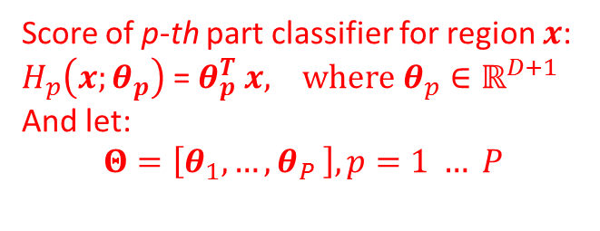
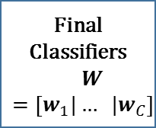

Contribution (SPLeaP)
Revisit earlier slide.
$P$ part classifiers
Head
Region Description
$$X={\left\{x_{r}\right\}}_{r=1 }^{R}$$
Where,
$x_{r}∈ ℝ^{D+1}$
Aggregation
$$f_{p}(X)=$$
$$\max_{r=1 … R}{{H_{p}(x}_{r};θ_{p})}$$
Part-based representation
$$f\left(X;Θ\right)={\left[f_{p}\left(X\right)\right]}_{p=1}^{P}$$
Final Classifiers
$$W=\left[w_{1}|… |w_{C}\right]$$
Body
Legs
$$…$$
Score of p-th part classifier for region $x$:
$H_{p}\left(x;θ_{p}\right)$ = $θ_{p}^{T} x, where θ_{p}∈ℝ^{D+1}$
And let:
$$Θ=\left[θ_{1}, …{,θ}_{P}\right], p=1 … P$$

Slide 11
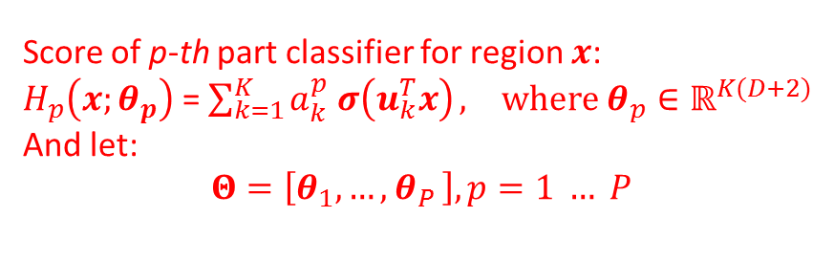
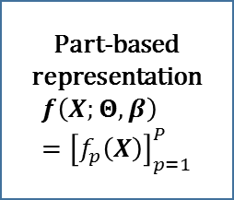
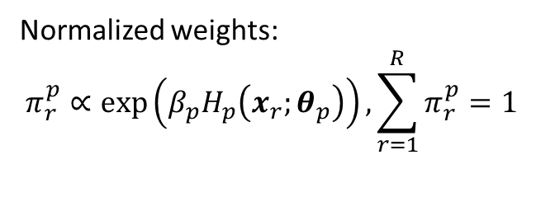
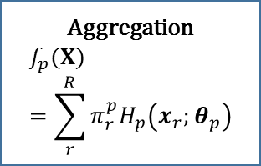
Contribution (SPLeaP)
1. A boosted non-linear part classifiers.
Normalized weights:
$$π_{r}^{p}∝\exp\left(β_{p}H_{p}\left(x_{r};θ_{p}\right)\right), \sum_{r=1}^{R}{π_{r}^{p}=1}$$
$P$ part classifiers
Head
Aggregation
$$f_{p}(X)=\sum_{r}^{R}{π_{r}^{p}H_{p}\left(x_{r};θ_{p}\right)}$$
Part-based representation
$$f\left(X;Θ,β\right)={\left[f_{p}\left(X\right)\right]}_{p=1}^{P}$$
Final Classifiers
$$W=\left[w_{1}|… |w_{C}\right]$$
Region Description
$$X={\left\{x_{r}\right\}}_{r=1 }^{R}$$
Where,
$x_{r}∈ ℝ^{D+1}$
Body
Legs
$$…$$
Score of p-th part classifier for region $x$:
$H_{p}\left(x;θ_{p}\right)$ = $\sum_{k=1}^{K}{a_{k}^{p} σ\left(u_{k}^{T}x\right)}, where θ_{p}∈ℝ^{K(D+2)}$
And let:
$$Θ=\left[θ_{1}, …{,θ}_{P}\right], p=1 … P$$

Slide 12
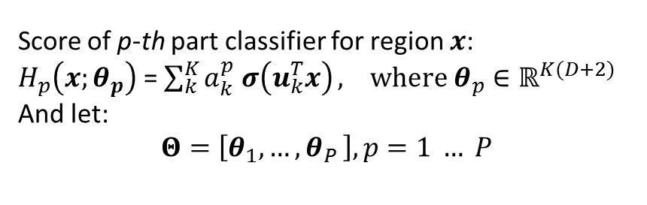
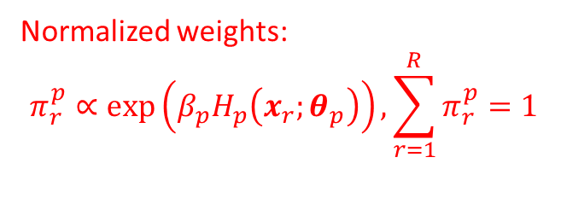
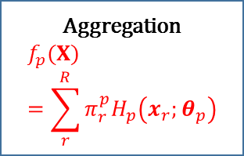
Contribution (SPLeaP)
2. Parametric Soft-Max Pooling.
Normalized weights:
$$π_{r}^{p}∝\exp\left(β_{p}H_{p}\left(x_{r};θ_{p}\right)\right), \sum_{r=1}^{R}{π_{r}^{p}=1}$$
$P$ part classifiers
Head
Aggregation
$$f_{p}(X)=\sum_{r}^{R}{π_{r}^{p}H_{p}\left(x_{r};θ_{p}\right)}$$
Part-based representation
$$f\left(X;Θ,β\right)={\left[f_{p}\left(X\right)\right]}_{p=1}^{P}$$
Final Classifiers
$$W=\left[w_{1}|… |w_{C}\right]$$
Region Description
$$X={\left\{x_{r}\right\}}_{r=1 }^{R}$$
Where,
$x_{r}∈ ℝ^{D+1}$
Body
Legs
$$…$$
Score of p-th part classifier for region $x$:
$H_{p}\left(x;θ_{p}\right)$ = $\sum_{k}^{K}{a_{k}^{p} σ\left(u_{k}^{T}x\right)}, where θ_{p}∈ℝ^{K(D+2)}$
And let:
$$Θ=\left[θ_{1}, …{,θ}_{P}\right], p=1 … P$$

Slide 13
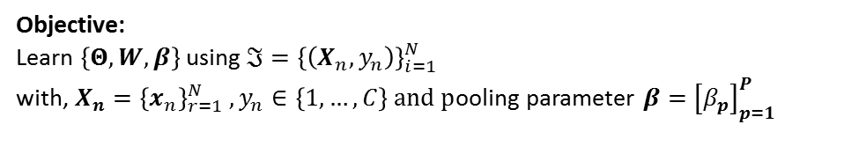
Contribution (SPLeaP)
Objective:
Learn $\left\{Θ,W,β\right\}$using $ℑ={\left\{\left(X_{n},y_{n}\right)\right\}}_{i=1}^{N}$
with, $X_{n}={\left\{x_{n}\right\}}_{r=1}^{N} , y_{n}∈\left\{1, …, C\right\} and p$ooling parameter $β={\left[β_{p}\right]}_{p=1}^{P}$
$P$ part classifiers
Head
Aggregation
$$f_{p}(X)=\sum_{r}^{R}{π_{r}^{p}H_{p}\left(x_{r};θ_{p}\right)}$$
Part-based representation
$$f\left(X;Θ,β\right)={\left[f_{p}\left(X\right)\right]}_{p=1}^{P}$$
Final Classifiers
$$W=\left[w_{1}|… |w_{C}\right]$$
Region Description
$$X={\left\{x_{r}\right\}}_{r=1 }^{R}$$
Where,
$x_{r}∈ ℝ^{D+1}$
Body
Legs
$$…$$
Score of p-th part classifier for region $x$:
$H_{p}\left(x;θ_{p}\right)$ = $\sum_{k}^{K}{a_{k}^{p} σ\left(u_{k}^{T}x\right)}, where θ_{p}∈ℝ^{K(D+2)}$
And let:
$$Θ=\left[θ_{1}, …{,θ}_{P}\right], p=1 … P$$

Slide 14
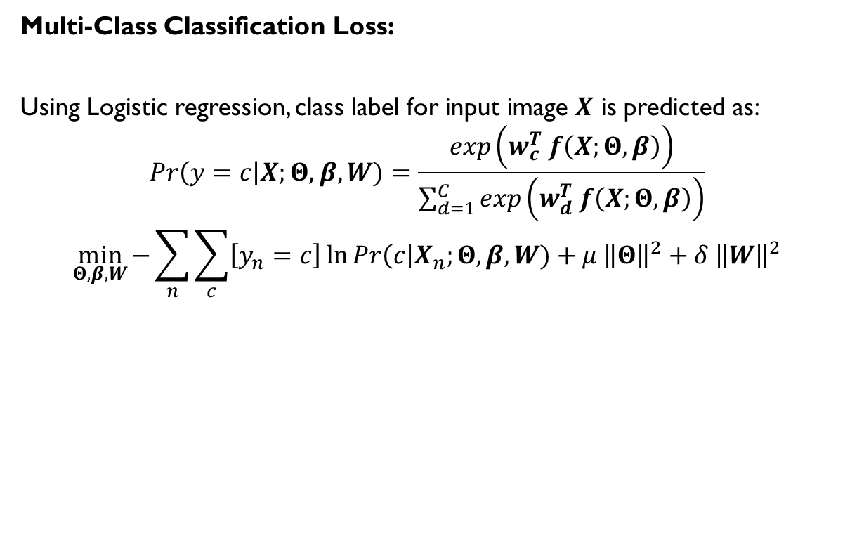
Contribution (SPLeaP)
Multi-Class Classification Loss:
Using Logistic regression, class label for input image $X$ is predicted as:
$$Pr\left(y=c\right|X;Θ,β,W)=\frac{exp\left(w_{c}^{T} f\left(X;Θ,β\right)\right)}{\sum_{d=1}^{C}{exp\left(w_{d}^{T} f\left(X;Θ,β\right)\right)}}$$
$$\min_{Θ,β,W}{−\sum_{n}{\sum_{c}{\left[y_{n}=c\right]\ln{Pr\left(c\right|X_{n};Θ,β,W)}}+μ {\left\|Θ\right\|}^{2}+δ {\left\|W\right\|}^{2}}}$$

Slide 15
Outline
Background:
Part-Based Models ( PBMs ) in context of Image Classification.
Motivation and Challenges.
Prior works.
Our Method:
Novel joint learning framework for learning parameters in PBMs.
Contribution:
A boosted non-linear part classifiers.
Parametric Soft-Max Pooling.
Results:
Datasets (Pascal VOC, MITindoor67 and Willow actions).
Comparison to prior SOA approaches.
Conclusion
Extensions

Slide 16
Results
Datasets:
Pascal-VOC-2007 (20 classes) - animals (e.g., dog, cat), vehicles (e.g., aeroplane, car) and other manufactured objects (e.g., tv monitor, chair).
MIT Indoor 67 (67 classes) - e.g., nursery, movie theater, casino or meeting room.
Willow dataset (7 classes) – e.g. play instrument, walk.
Performance measure:
mean Average Precision (mAP) for Pascal-VOC and Willow.
Accuracy (acc) for MIT dataset.
Region proposal schemes: Selective search, dense sampling.
Region feature extraction:
128-D from 13-layer arch (VGG-128)
4096-D from 16-layer architecture (VD-16)
Krizhevsky's architecture pre-trained using ImageNet + Places database (HybridCNN).

Slide 17
Results
Pascal-VOC-2007
Methods | mAP
VGG128-G | 75.5
Oquab et al | 77.31
Li et al | 77.90
Cimpoi et al | 79.50
CNN-S fine tuned | 82.42
SPLeaP-VGG-128 | 84.68
Methods | mAP
VD-16-G | 81.73
VD-16 (dense evaluation) | 84.67
Cimpoi et al | 85.1
SPLeaP-VD-16 | 88.01

Slide 18
Results
MIT indoor67 (left) and Willow (right):
Methods | acc
Gong et al | 68.80
Li et al | 69.69
HybridCNN-G | 72.54
Parizi et. al | 73.30
SPLeaP- HybidCNN | 73.45
Methods | mAP
Khan et al | 70.1
Sicre et al | 81.90
VD-16-G | 85.12
VD-16 (dense evaluation) | 85.67
SPLeaP – VD-16 | 88.47

Slide 19
Results
Visualization ( Selectivity of Part Classifiers using heatmaps):
Heatmaps for images Pascal-VOC-2007 of classes (clockwise from top-left)
“potted plant", “bird", “bottle" and “TV monitor".

Slide 20
Results
Visualization ( Specialization of Part Classifiers to discriminative regions):
Discriminative parts for the four Pascal-VOC-2007 classes (clockwise from
top-left) “horse", “motorbike", “dining table", and “potted plant".

Slide 21
Outline
Background:
Part-Based Models ( PBMs ) in context of Image Classification.
Motivation and Challenges.
Prior works.
Our Method:
Novel joint learning framework for learning parameters in PBMs.
Contribution:
A boosted non-linear part classifiers.
Parametric Soft-Max Pooling.
Results:
Datasets (Pascal VOC, MITindoor67 and Willow actions).
Comparison to prior SOA approaches.
Conclusion
Extensions

Slide 22
Conclusion
We introduce SPLeapP, a novel part-based model for image classification.
Based on non-linear part classifiers combined with part-dependent soft pooling both being trained jointly with the image classifiers surpasses standard pooling approaches and other PBMs on several challenging classification tasks.
Our method does not need any particular initialization of parts.

Slide 23
Extensions
Fast Region-based CNN method for image classification.
Possible directions for improvements in performance:
  Data Augmentation - Multi Scale testing and training.
  Region description - conv5 or fc7 based descriptors.
  Make each Part Classifier deep.

Slide 24
Extensions
Fast Region-based CNN method for image classification.
Possible directions for improvements in performance:
  Data Augmentation - Multi Scale testing and training.
  Region description - conv5 or fc7 based descriptors.
  Make each Part Classifier deep.

Slide 25
Extensions
Computing CNN descriptors for all the candidate region proposals is costly.
We currently rely on penultimate layer i.e. fully connected layer for describing each region. Instead can we leverage the advantage of multiple layers in the CNN ?

Slide 26
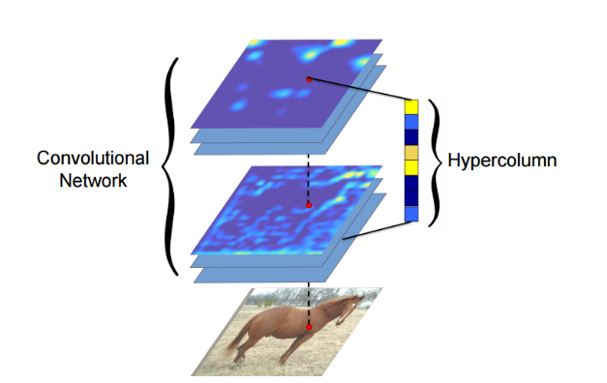
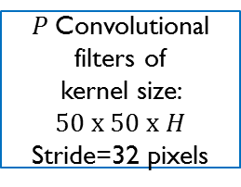
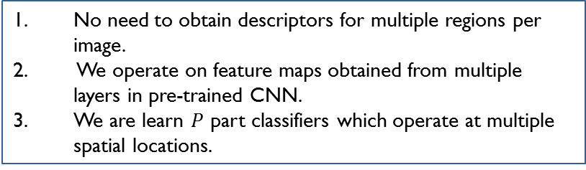

Extensions
Upsampled feature maps obtained from pre-trained network [6]
Mini network trained on Pascal VOC 2007
$P$Convolutional filters of
kernel size:
$$50 x 50 x H$$
Stride=32 pixels
Spatial softmax pooling
Final Classifier.
Problems addressed
Let $H$, be length of hyper column.
No need to obtain descriptors for multiple regions per image.
We operate on feature maps obtained from multiple layers in pre-trained CNN.
We are learn $P$ part classifiers which operate at multiple spatial locations.
[6] Hariharan, B., Arbeláez, P., Girshick, R., & Malik, J. (2015). Hypercolumns for object segmentation and fine-grained localization. In Proceedings of the IEEE Conference on Computer Vision and Pattern Recognition (pp. 447-456).

Slide 27
References
1. Juneja, M., Vedaldi, A., Jawahar, C., Zisserman, A.: Blocks that shout: Distinctive parts for scene classification. In: CVPR (2013)
2. Doersch, C., Gupta, A., Efros, A.A.: Mid-level visual element discovery as discriminative mode seeking. In: NIPS (2013)
3. Singh, S., Gupta, A., Efros, A.: Unsupervised discovery of mid-level discriminative patches. In: ECCV. (2012)
4. Parizi, S.N., Vedaldi, A., Zisserman, A., Felzenszwalb, P.: Automatic Discovery and Optimization of Parts for Image Classification. In: ICLR. (2015)
5. Li, Y., Liu, L., Shen, C., van den Hengel, A.: Mid-level deep pattern mining. In: CVPR (2015).
6. Gong, Y., Wang, L., Guo, R., Lazebnik, S.: Multi-scale orderless pooling of deep convolutional activation features ECCV (2014).
7. Cimpoi, M., Maji, S., Vedaldi, A.: Deep filter banks for texture recognition and segmentation. In: CVPR. (2015)
8. Chatfield, K., Simonyan, K., Vedaldi, A., Zisserman, A.: Return of the Devil in the Details: Delving Deep into Convolutional Nets. In BMVC 2014.
9. Simonyan, K., Zisserman, A.: Very deep convolutional networks for large-scale image recognition. In: ICLR
10. Krizhevsky, A., Sutskever, I., Hinton, G.E.: ImageNet Classication with Deep Convolutional Neural Networks. In NIPS 2012.
11. Oquab, M., Bottou, L., Laptev, I., Sivic, J.: Learning and transferring mid-level image representations using convolutional neural networks.

Slide 28
Thank You
Questions ?

